Slide 1
Welcome to Week 12
Neural Networks
Dr. Umer Altaf

Slide 2
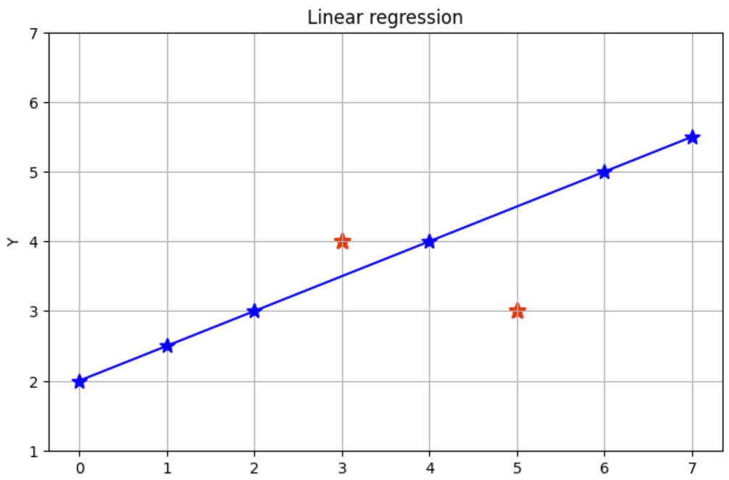
Neural Network
What is the Error here?

Slide 3
Neural Network
Coefficients
Linear Regression
Y = β₁X₁ + β₂X₂ + β₀
Error Term

Slide 4
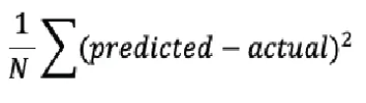
Neural Network
What is the Error here?
MSE = = 1/8{(4-3.5)² + (3 – 4.5)²} = 0.31

Slide 5
Neural Network Terminologies
Coefficients
Linear Regression
Y = β₁X₁ + β₂X₂ + β₀
Error Term
Minimizing the error
Neural Networks
Y = β₁X₁ + β₂X₂ + β₀
Bias
Minimizing the cost function/loss function
Weights

Slide 6
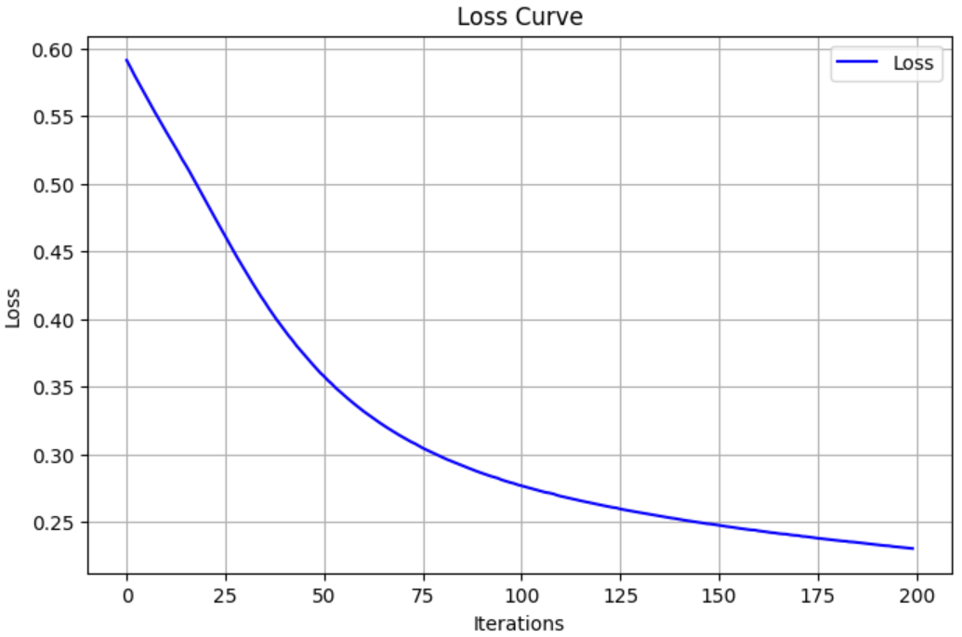
Neural Network – Loss Function

Slide 7
Housing Price Prediction
neuron
size
price
price
size of house

Slide 8
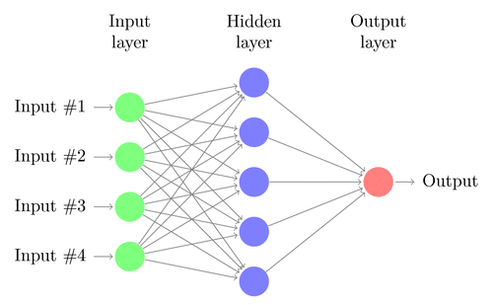
Neural Networks
Input
layer
Output
layer
Input X₁
Perceptron
w₁
Input X₂
w₂
Output
w₃
Input X₃
w₄
Input X₄
[Shallow] 2 Layer Neural Network
Input X₁
Input X₂
Input X₃
Input X₄

Slide 9
# Apples | # Oranges | Total Cart Value (Target Variable Y)
2w₁ | 6w₂ | $15
3w₁ | 5w₂ | $13
5w₁ | 1w₂ | $14
5 | 5 | ??
Training data gives
w₁ = 2 , w₂ = 1
Model
Y = w₁x₁ + w₂x₂ + some error
Y = 2*5 + 1*5 + some error
Cart value is $15

Slide 10
Perceptron: Building Block of Neural Networks
Number of Apples
w₁
Bias
w₁x₁ + w₂x₂
+ some bias
Cart value (Y)
Number of Oranges
w₂
Output Neuron
Input Neurons

Slide 11
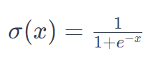


Perceptron: Logistic Regression
1 = Yes
0 = No
Applicant Income | Credit History | Loan Eligibility (Target Variable Y)
5846w₁ | 1w₂ | 1
3255w₁ | 0w₂ | 0
5988w₁ | 1w₂ | 1
4588 | 1 | ??
Training data gives
w₁ = 3 , w₂ = 2
Model
Y = w₁x₁ + w₂x₂ + some error
Now based on your threshold (decision boundary) the model decides whether the output value is 1 or 0

Slide 12
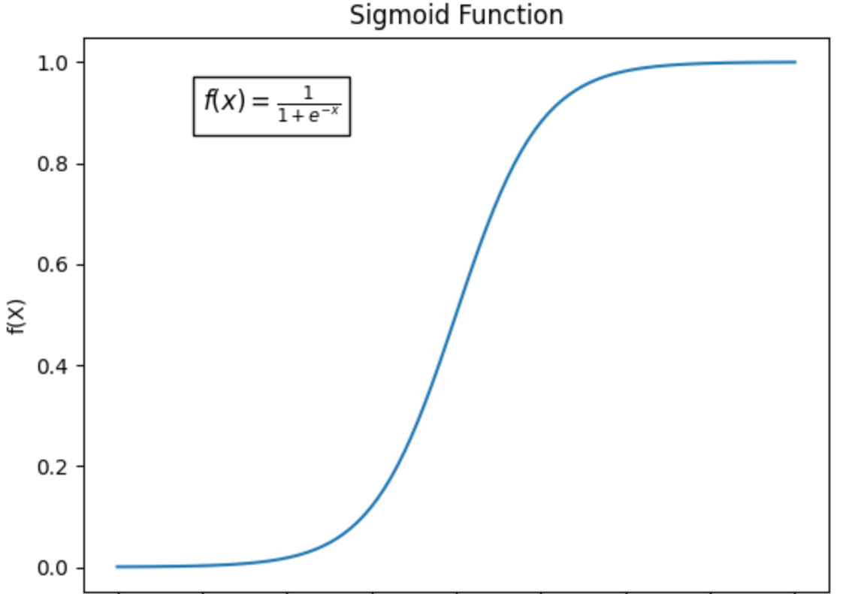
Perceptron: Building Block of Neural Networks
Applicant Income
w₁
Bias
w₁x₁ + w₂x₂
+ some bias
Eligible (Y)
Credit History
w₂
Activation function
Input Neurons
Output Neuron
Note: Activation function in the output layer has a different role than the activation functions in the hidden layers.

Slide 13









Non-technical explanation of deep learning
Product Research
Content Creation
Budgeting
Industry Analysis
Analyze customer behavior
Risk Management
The CEO
Analyze market trends
Research
Marketing
Finance

Slide 14
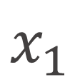
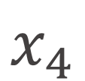
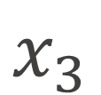
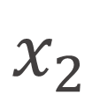
Housing Price Prediction – 2 Layer Neural Network
size
$$x_{1}$$
w₁₁
w₁₂
b₁
#bedrooms
$$x_{2}$$
w₁₃
y
zip code
$$x_{3}$$
wealth
$$x_{4}$$

Slide 15
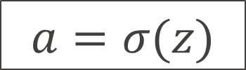
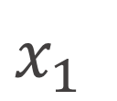
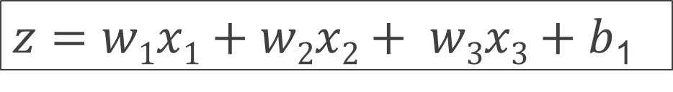

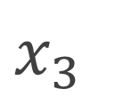
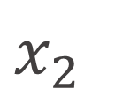
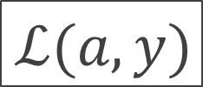
Neural Network – One Layer / One Neuron
$$x_{1}$$
$$x_{2}$$
$$\hat{y}$$
$$x_{3}$$
x
w
$z=w1x1+w2x2+ w3x3+b$₁
$$a=σ(z)$$
$$ℒ(a,y)$$
b

Slide 16




Neural Network
$$x_{1}$$
Layers ?
Hidden Layers ?
$$x_{2}$$
$$\hat{y}$$
$$x_{3}$$

Slide 17

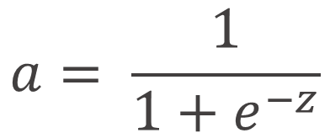
Neural Network – Activation Function
a
1
z
$$a= \frac{1}{1+e^{−z}}$$
sigmoid:

Slide 18
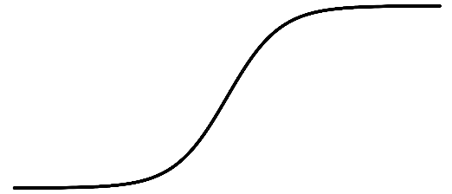
Neural Network – Activation Function
a
x
a
a
z
z

Slide 19
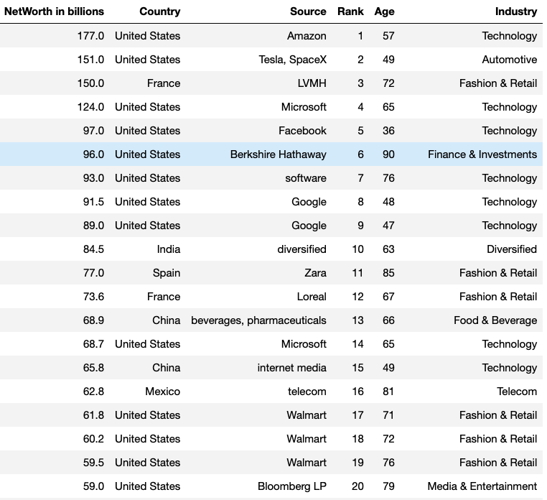
Hyper parameters in Neural Networks
Batch Size
Epochs
Hidden layers
Number of neurons
Activation function
Input X₁
Input X₂
Input X₃
e.g.
Batch size = 5
Iterations = 10
(specific to Tensorflow and Pytorch) number of epochs = 1
Input X₄

Slide 20
Neural Networks
Input
layer
Output
layer
Input X₁
Perceptron
w₁
Input X₂
w₂
Output
w₃
Input X₃
w₄
Input X₄
Shallow Neural Network
Deep Neural Network
Input X₁
Input X₂
Input X₃
Input X₄

Slide 21
Why Deep Learning
Underfit
High Bias (train error)
Generalised
Overfit
High variance (test error)
Error
Error
Error
Validation
Validation
Training
Validation
Training
Training
Iterations
Iterations
Iterations

Slide 22
Operations of hidden layers
Google Tensorflow Playground Demo

Slide 23
Launch UCLA - Neural_Networks_Solutions.ipynb Notebook

Slide 24
Thank you!

